Slide 1
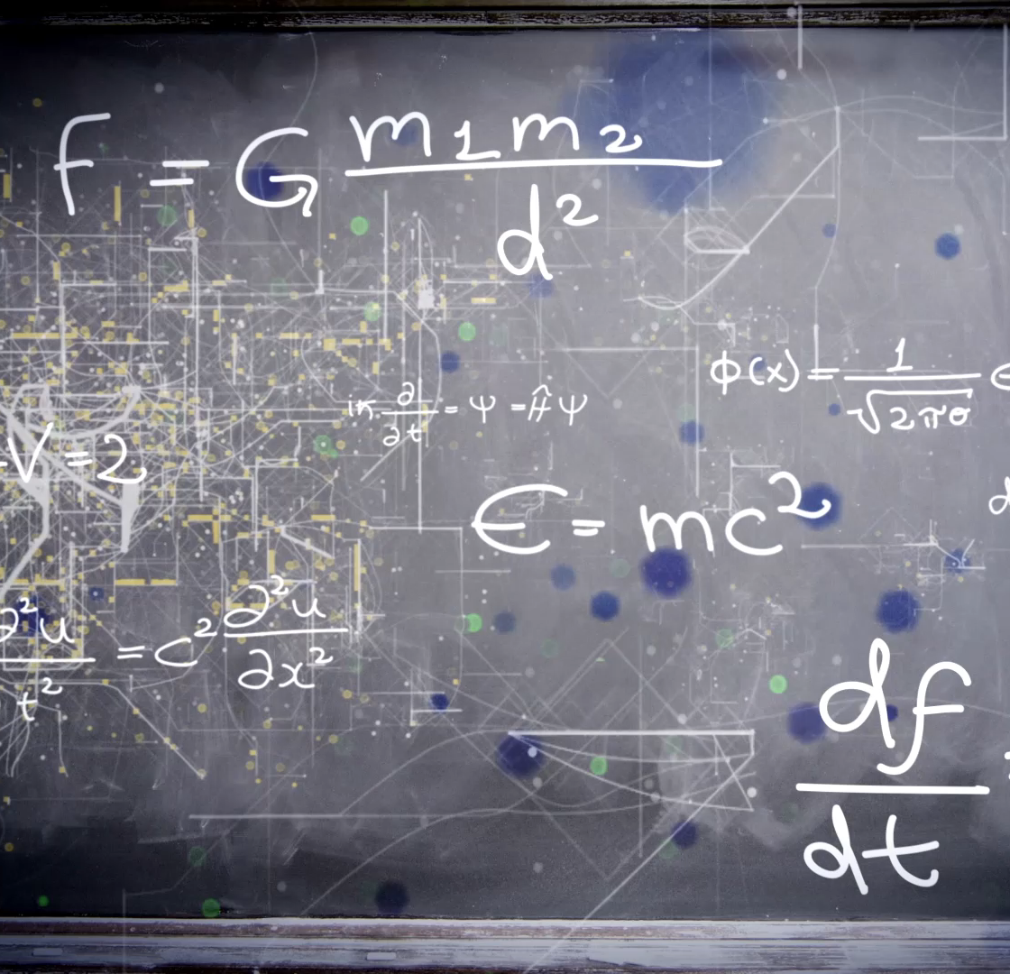
Fundamentals of Image Processing
Exploring the core aspect of Computer Vision
Instructor: Stephin Rachel Thomas 22-01-2026

Slide 2

Today’s Topics
Introduction to Image Processing
It’s importance in Machine Vision
Steps involved in Image processing
Introduction to Image Filtering
Image Blurring
Image Sharpening
Edge Detection using Canny
Image Histograms
Image Thresholding
Morphological operations
Image Transformation Techniques

Slide 3

Introduction to Image Processing
Image Processing is the building block of Machine Vision.
It involves manipulation and analysis of images.
It enhances quality of image and extract meaningful information.

Slide 4

Why is Image Processing used in Machine Vision?
Enhancement: Improves image quality by reducing noise, enhancing contrast, and sharpening details, making it easier to analyze.
Feature Extraction: Identifies and extracts important features like edges, corners, and textures, which are crucial for recognizing objects and patterns.
Segmentation: Divides an image into meaningful regions or objects, facilitating object detection and classification.
Object Recognition: Helps in identifying and classifying objects within an image, which is essential for applications like automated inspection and robotics.
Measurement: Allows for precise measurement of object dimensions, distances, and other parameters, which is vital in quality control and industrial automation.

Slide 5
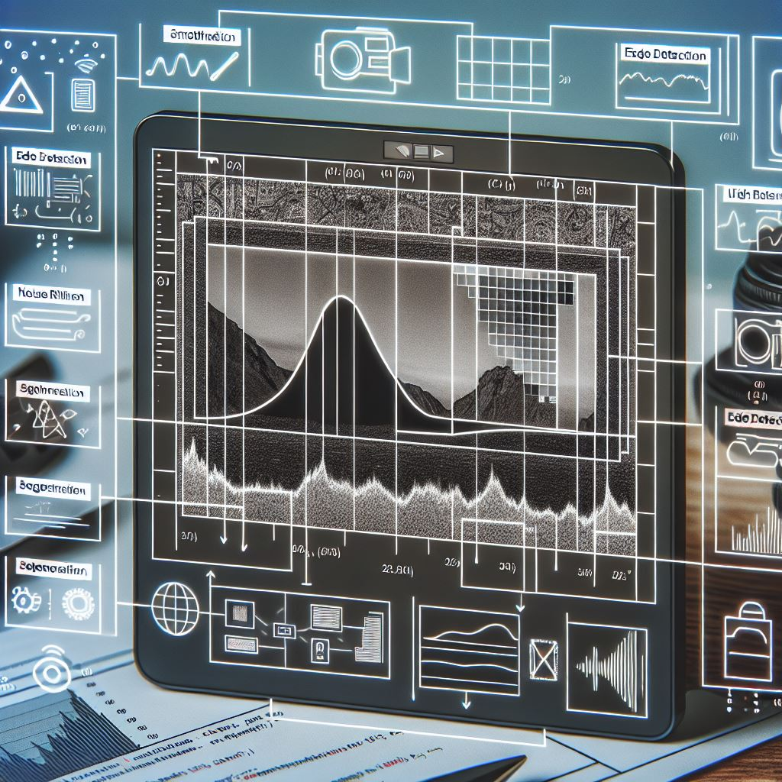
Key stages in Image Processing
Acquisition
Enhancement
Restoration
Morphological processing
Segmentation
Object recognition
Representation and description
Image compression
Colour Image Processing

Slide 6
Key stages in Image Processing
Based on the application combination of 2 or 3 steps can be used. It is not mandatory that all these steps are to be done In every image processing task.
Image Acquisition – Acquiring image using digital camera or sensors
Image enhancement – manipulates image so that the result is more suitable than the original image for specific application. This step brings out hidden details of an image and highlights certain features which may be important for further analysis.
Image restoration – Process of improving the appearance of image. Eg: removal of noise includes mathematical or probabilistic models of image degradation
Morphological processing – deals with tools for extracting image components that are useful in the representation and description of shape. Eg: fingerprint recognition

Slide 7
Key stages in Image Processing
Image segmentation – one of the most difficult task, it partition an image into its constituent parts or objects.
Object Recognition: The process that assigns a label to an object based on the information provided by its description
Representation and description: Choosing a representation for transforming raw data into a form suitable for subsequent computer processing boundary representation or region representation
Image Compression: Reducing storage required to save an image
Color image processing: Involves use of color of image to extract meaningful information

Slide 8
Introduction to Image Filtering
Filtering in image processing is a technique used to manipulate or enhance an image by altering its pixels. It's a fundamental tool that can either amplify certain features or suppress unwanted distortions.
Filters act like a sieve through which the original image is passed: they can highlight specific attributes, remove noise, or prepare the image for further analysis.

Slide 9

Image Blurring
Blurring is a type of filtering that softens an image. It’s used to reduce detail and noise
Blurring works by averaging the pixels around a target pixel, which smooths out rapid intensity changes.
The filter used here is:[[1,1,1],[1,1,1],[1,1,1]]

Slide 10
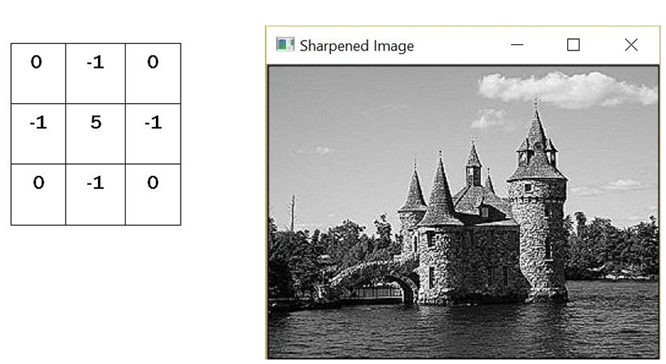
Image Sharpening
Sharpening, in contrast to blurring, is a filter that enhances the edges and details in an image, making it appear clearer and more defined.
It increases the contrast between adjacent pixels to highlight boundaries of objects within the image.
This technique is vital when details are critical for analysis, such as in medical imaging or precision manufacturing

Slide 11
Basic Image Manipulations
Let's explore basic manipulations like resizing, cropping, and rotating images. These are the bread and butter of image processing – simple yet powerful tools in our visual toolkit.

Slide 12
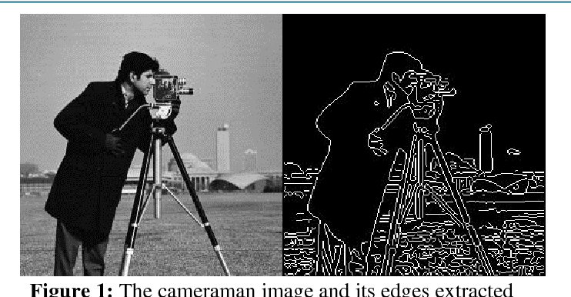
Edge Detection using Canny
The Canny filter is a sophisticated edge detection algorithm that is known for its precision in detecting a wide range of edges in images.
It involves multiple stages:
Noise Reduction - By smoothing the image with a Gaussian filter
Gradient Calculation - Finding intensity gradients and its direction at each pixel. Smoothened image is then filtered with a Sobel kernel in both horizontal and vertical direction to get first derivative in horizontal direction and vertical direction

Slide 13
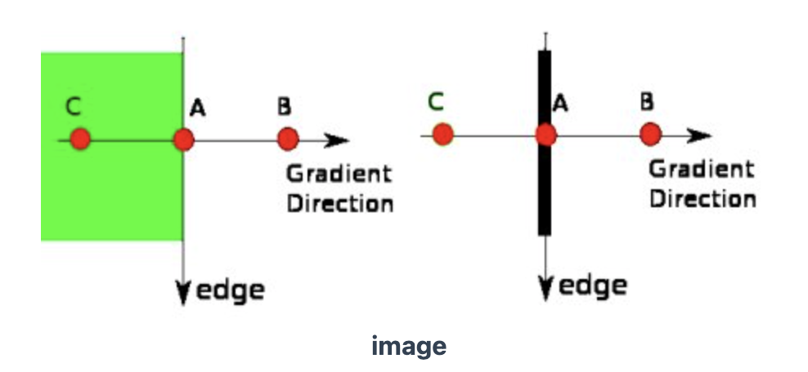
Edge Detection using Canny
Non-maximum Suppression – Thins out edges by suppressing non-maximum gradient values
Double Thresholding – Algorithm applies 2 thresholds (high and low) to classify edges into strong, weak and non-edges
Edge Tracking by Hysteresis- the algorithm tracks edges by connecting weak edges to strong edges, helps to preserve true edges while discarding isolated weak edges caused by noise.
https://docs.opencv.org/5.x/da/d22/tutorial_py_canny.html

Slide 14
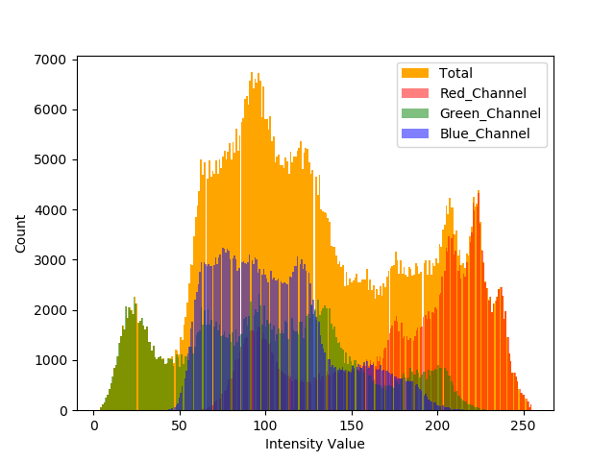
Image Histograms
An image histogram is a chart that shows how many pixels in an image have a particular brightness level. The horizontal axis shows different brightness levels, from dark to light, and the vertical axis shows how many pixels are at each level. It helps us understand if an image is mostly bright, dark, or balanced, and is useful for improving the image's look.

Slide 15
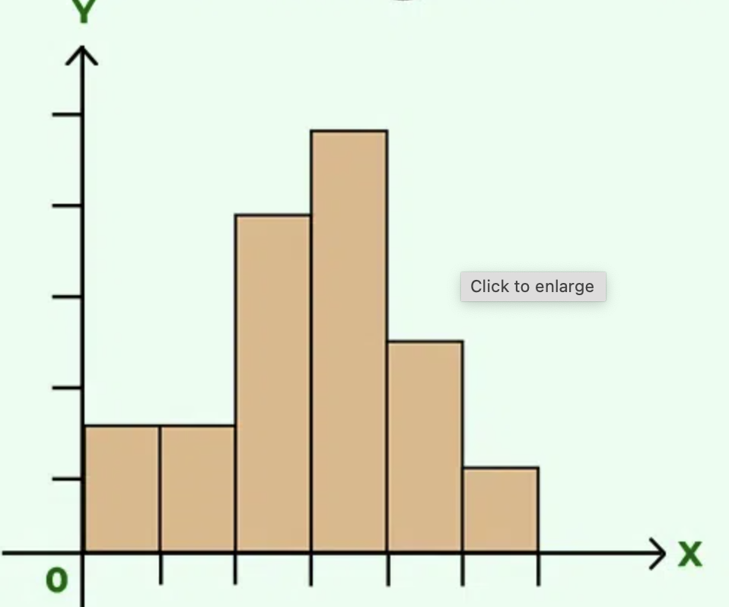
What is Histogram?
Histogram is a graph or plot, which gives you an overall idea about the intensity distribution of an image.
It is a plot with pixel values (ranging from 0 to 255) in X-axis and corresponding number of pixels in the image on Y-axis.
Left region of histogram shows the amount of darker pixels in image and right region shows the amount of brighter pixels.

Slide 16
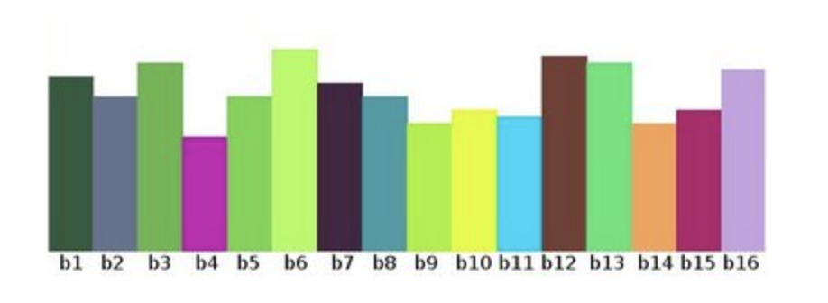
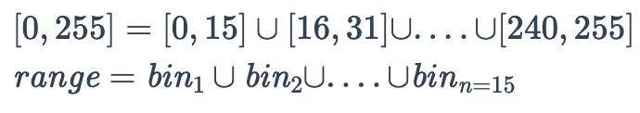
Histogram and bin
We can segment our range in subparts
(called bins)
https://docs.opencv.org/5.x/d8/dbc/tutorial_histogram_calculation.html

Slide 17
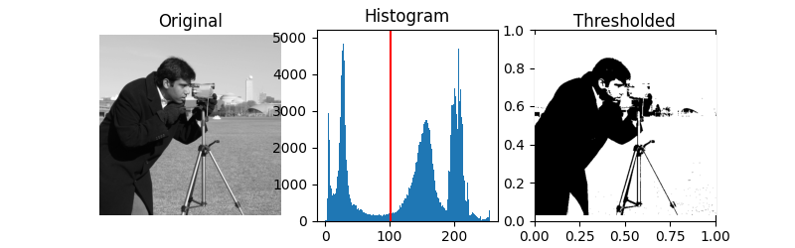
Image Thresholding
Thresholding is a simple yet effective way to segment images.
By converting an image to black and white based on a threshold value, we can isolate objects or features easily.

Slide 18
Image Thresholding
Simple Thresholding
For every pixel, the same threshold value is applied. If the pixel value is smaller than or equal to the threshold, it is set to 0, otherwise it is set to a maximum value.
Adaptive Thresholding
The algorithm determines the threshold for a pixel based on a small region around it. So we get different thresholds for different regions of the same image which gives better results for images with varying illumination.

Slide 19

Morphological Operations
Morphology is a broad set of image processing operations that process images based on shapes.
Erosion: Shrinks objects.
The kernel slides through the image (as in 2D convolution). A pixel in the original image (either 1 or 0) will be considered 1 only if all the pixels under the kernel is 1, otherwise it is eroded (made to zero).
All the pixels near boundary will be discarded depending upon the size of kernel. So the thickness or size of the foreground object decreases or simply white region decreases in the image.
It is useful for removing small white noises, detach two connected objects etc.
Left image: original image, right image: resulting erosion

Slide 20

Morphological Operations
Dilation: Expands objects.
A pixel element is '1' if at least one pixel under the kernel is '1'. So it increases the white region in the image or size of foreground object increases.
Normally, in cases like noise removal, erosion is followed by dilation.
It is also useful in joining broken parts of an object.
Left image: original image, right image: resulting dilatation

Slide 21


Morphological Operations
Opening: Removes small objects (erosion followed by dilation).
Erosion removes white noises, but it also shrinks our object. Then we dilate it. Since noise is gone, they won't come back, but our object area increases. It is also useful in joining broken parts of an object.
Closing: Fills small holes (dilation followed by erosion).
It is useful in closing small holes(filling the gap) inside the foreground objects, or small black points on the object.
Application: Medical Imaging, Robotics, Computer Vision, Document processing
Opening
Closing

Slide 22
Image Transformation Techniques
Image transformation techniques are essential tools in digital image processing, allowing for various modifications and enhancements to image.
Affine transformation – Preserve lines and parallelism in the image. y = Ax + b
x: The input vector (e.g., a point in 2D or 3D space).
A: A matrix that applies a linear transformation (like rotation, scaling, or shearing).
b: A vector that applies a translation (shifts the result).
y: The output vector after the transformation.

Slide 23
Image Transformation Techniques
Translation: Shifting the image in the x or y direction.
Rotation: Rotating the image around a specified point.
Scaling: Changing the size of the image.
Shearing: Slanting the image along the x or y axis.

Slide 24
Next Week Preview
Next week, we'll dive into the Feature detection and Description.

